Slide 1


OBJECT ORIENTED ANALYSIS AND DESIGN PROJECT REVIEW
Department of Computer Science and Engineering
Academic Year: 2024 – 2025 (Odd Semester)
PRESENTED BY SUPERVISOR
SUREKA V - 2303811710422162 MRS.V.KALPANA
TEJES SHREE J - 2303811710422167
VARUNIKA S - 2303811710422175
YAZHINI P - 2303811710422185

Slide 2
Title of the Project
MOVIE TICKET BOOKING SYSTEM

Slide 3
Introduction
The Movie Ticket Booking System aims to digitize and streamline the traditional method of purchasing movie tickets. Users can explore available movies, view detailed show information, choose seats, make payments, and share feedback all from a single website. The admin side allows complete control over movie management, show schedules, and booking records. By integrating multiple modules such as booking pages, payment options, QR payment, and reviews, the system delivers a seamless and efficient ticket booking experience for both users and administrators.

Slide 4
Problem Identification
Traditional movie ticket booking involves long queues, manual errors, and limited access to real-time seat availability. Existing systems often lack secure payment handling and proper booking management. Theatre administrators also face difficulties in efficiently managing movies, bookings, and customer feedback, creating the need for a reliable web-based solution.

Slide 5
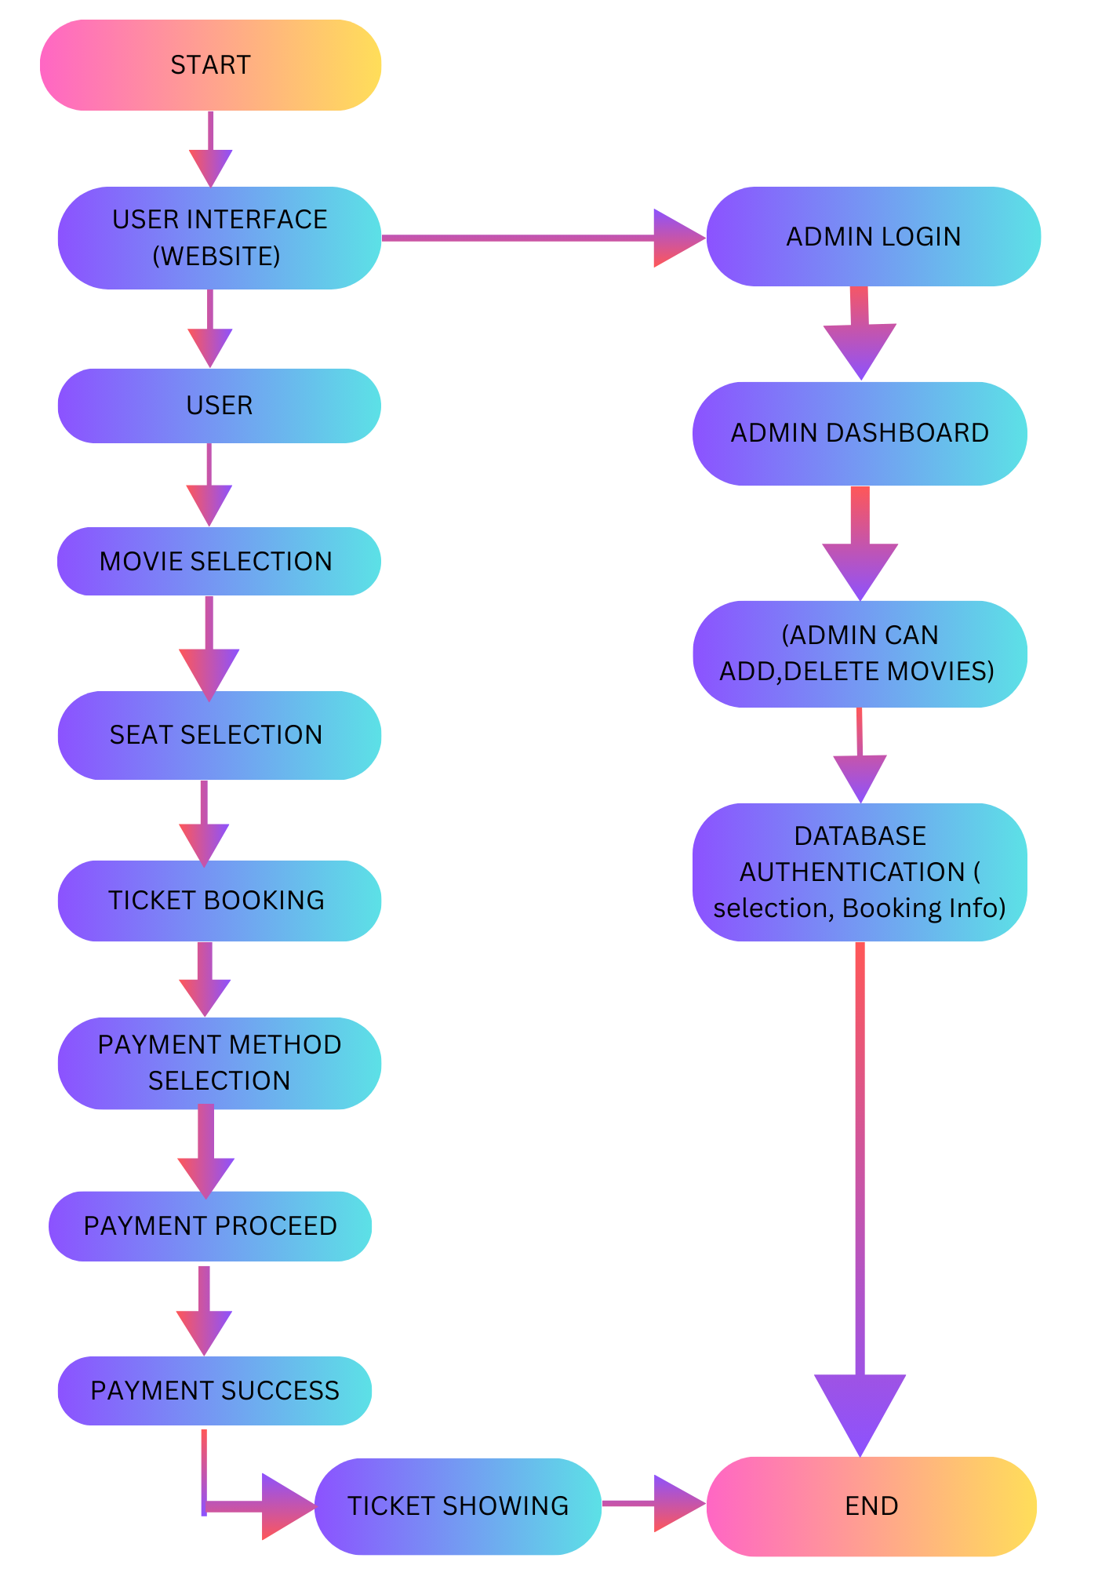
Proposed Architecture

Slide 6
Proposed Architecture - Description
The system starts with the user accessing the website and interacting through the user interface.
Users browse and select movies, then proceed to ticket booking and seat selection.
After choosing seats, users select a payment method and are redirected to the payment module.
The payment process verifies the transaction and, on success, generates and displays the ticket.

Slide 7
Proposed Architecture - Description
Admins log in separately to manage movies, view bookings, and monitor system activity through the admin dashboard.
All user actions and admin operations are authenticated and stored through the database module.
The system ensures smooth data flow between booking, payment, and admin management before reaching the end of the process.

Slide 8
OOAD - Concepts Used
1. Use Case Model
Shows the interactions between users (Customer/Admin) and the system. Helps identify all main functions and requirements.
2. Activity Diagram
Represents the step-by-step workflow of system processes. Shows how booking, payment, and admin tasks flow from start to end.
3. Class Diagram
Defines system classes with their attributes, methods, and relationships. Provides the structural blueprint of the entire system.

Slide 9
OOAD - Concepts Used
4. Sequence Diagram
Shows the order of interactions between objects during processes like ticket booking and payment.
5. Compound Diagram
Gives a combined view of different system components and how they work together.
6. Collaboration Diagram
Illustrates how objects communicate and exchange messages to complete a task.
7. Deployment Diagram
Shows how the system is deployed across hardware like user devices, servers, and the database.
8. Package Diagram
Organizes the system into logical packages such as User Module, Booking Module, and Payment Module.

Slide 10
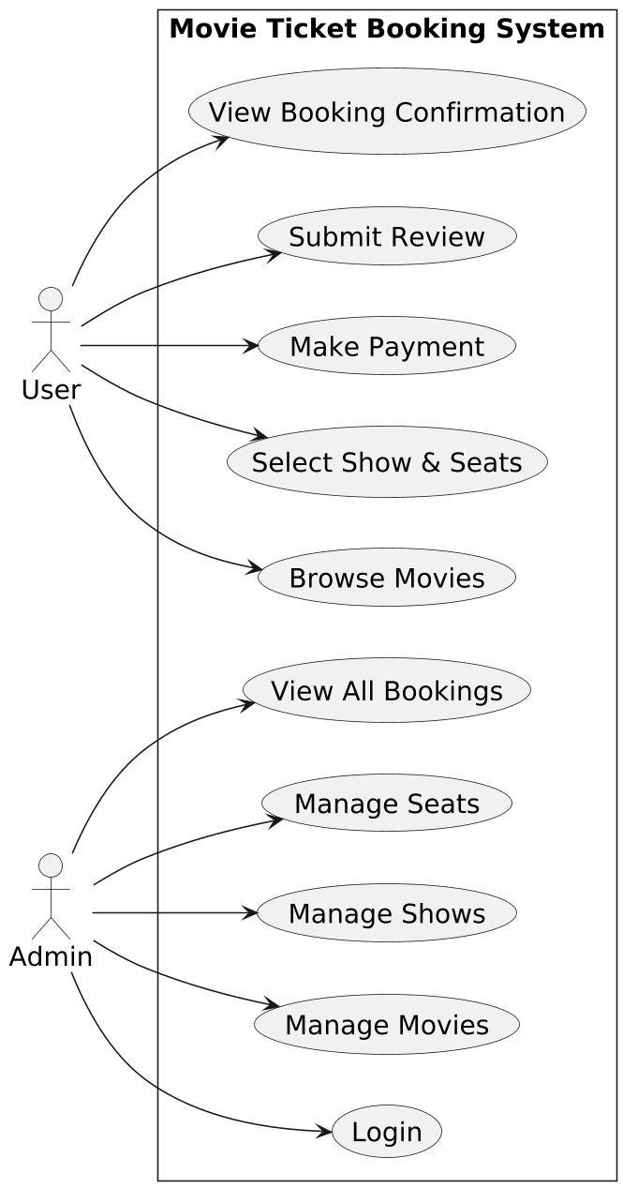
Use Case Diagram

Slide 11
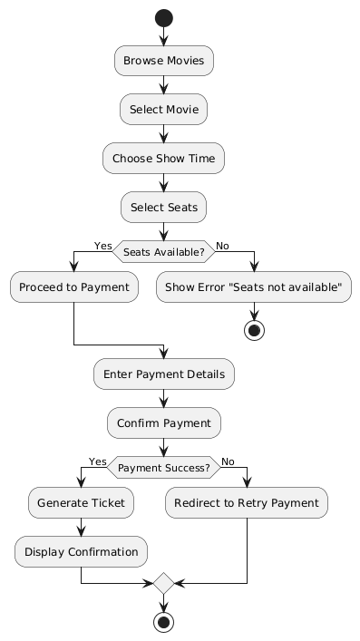
Activity Diagram

Slide 12
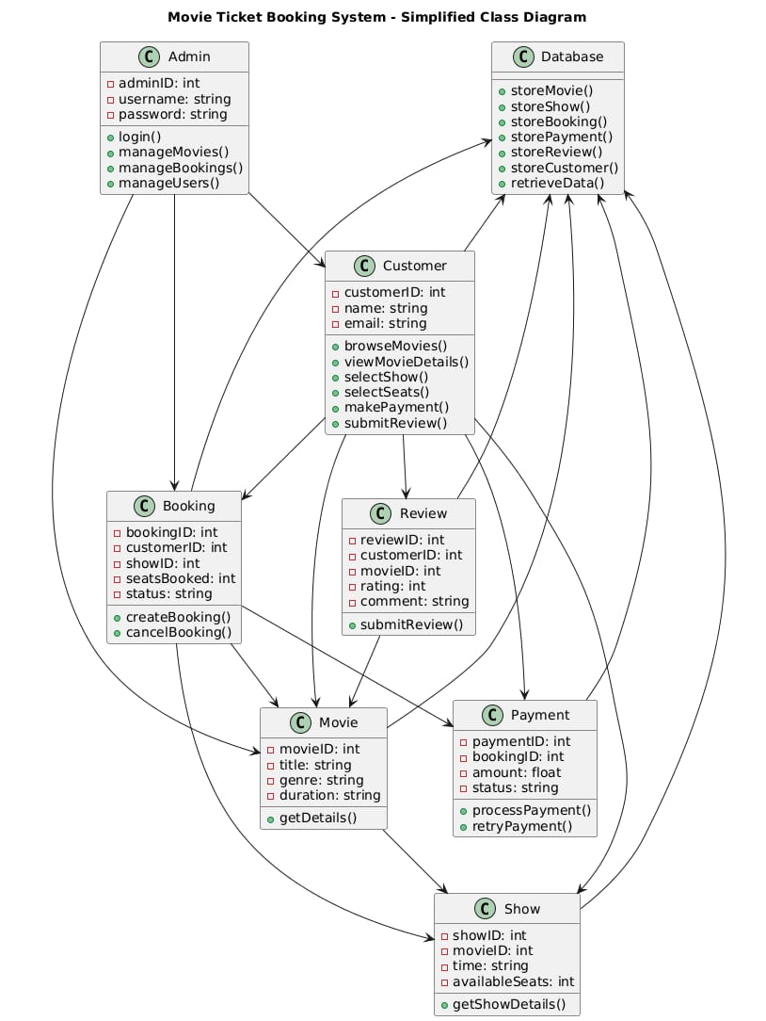
Class Diagram

Slide 13
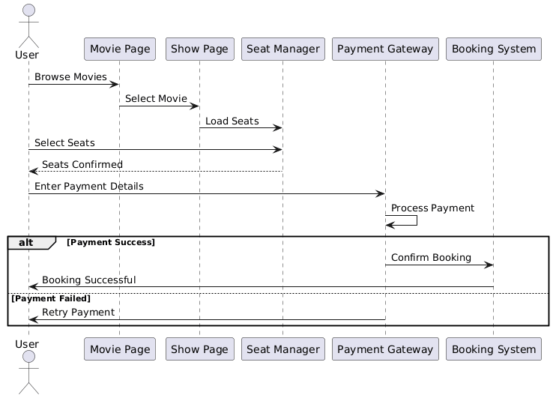
Sequence Diagram

Slide 14
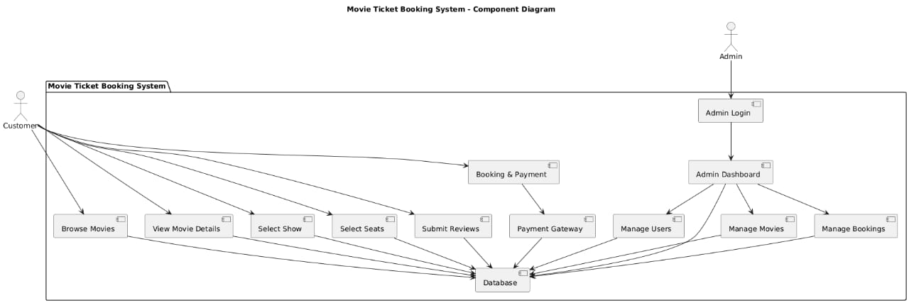
Component Diagram

Slide 15
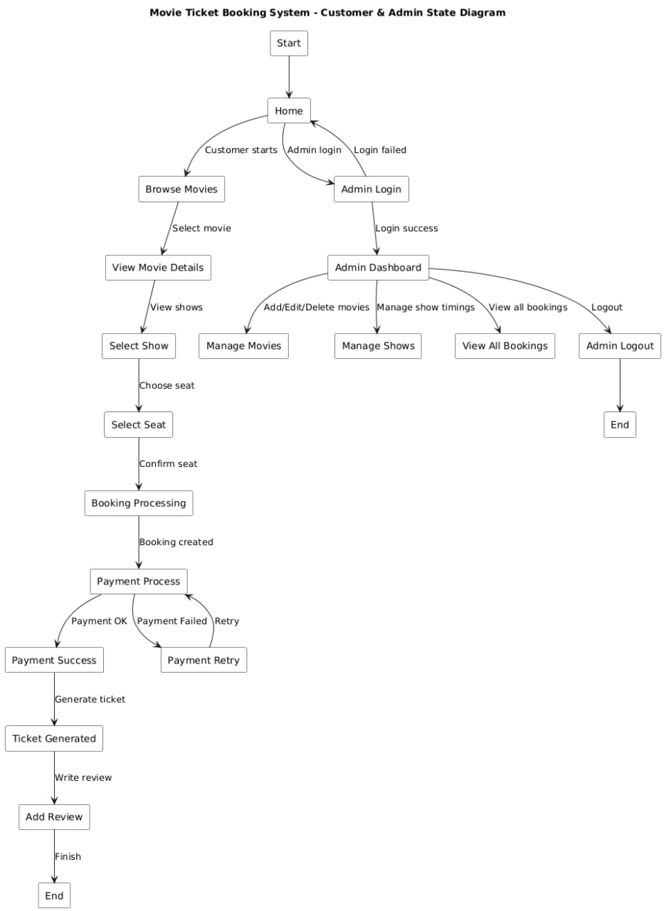
State Machine Diagram

Slide 16
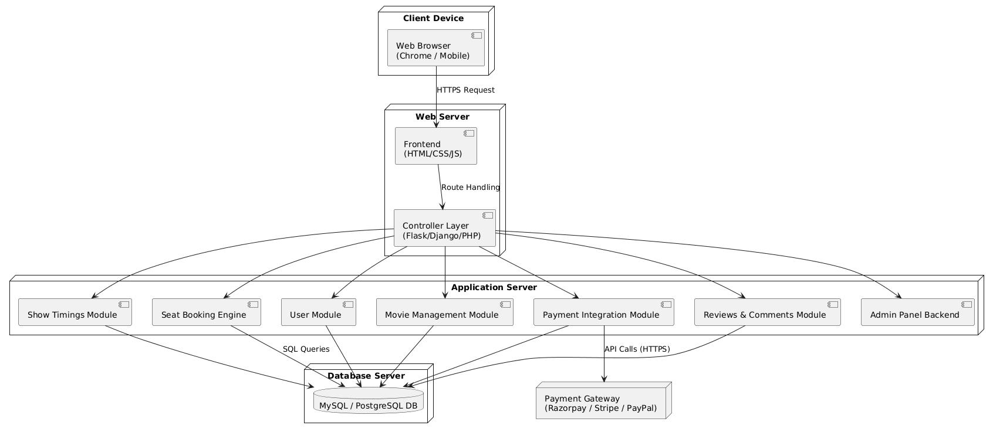
Deployment Diagram

Slide 17
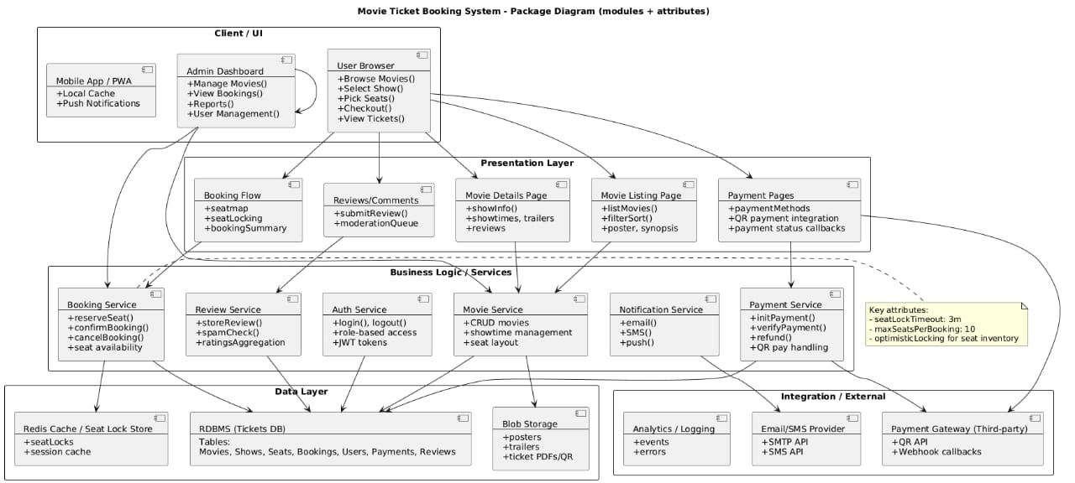
Package Diagram

Slide 18
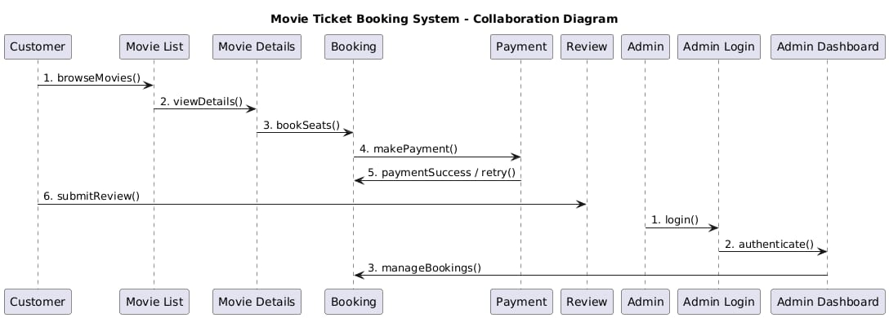
Collaboration Diagram

Slide 19
List of Modules
User Management
Movie & Show Selection
Ticket Booking
Payment Processing
Booking History
Admin
Admin Dashboard

Slide 20
Module Description
User Management
Users can register, log in securely, and access the system based on their role (Customer/Admin). Admins manage operations, while customers browse movies and book tickets.
Movie & Show Selection
Customers can view movies, details, trailers, and choose theatres, showtimes, and formats. An interactive seat layout shows available seats and prevents double-booking.
Ticket Booking
Users select seats from the seat map and confirm showtime, seat type, and ticket count. The system checks seat availability in real time before booking.
Payment Processing
Payments are completed through a simulated online gateway for ticket confirmation. After successful payment, a digital ticket is generated.

Slide 21
Module Description (Cont..)
Booking History
Users can view all past and upcoming reservations in one place. Each entry shows date, time, seat details, and payment status.
Admin
Passwords are hashed and sessions are protected from unauthorized access. Only authenticated users can view or manage bookings.
Admin Dashboard
Admins manage movies, shows, timings, bookings, and seat availability. They can also handle cancellations and review customer feedback.

Slide 22
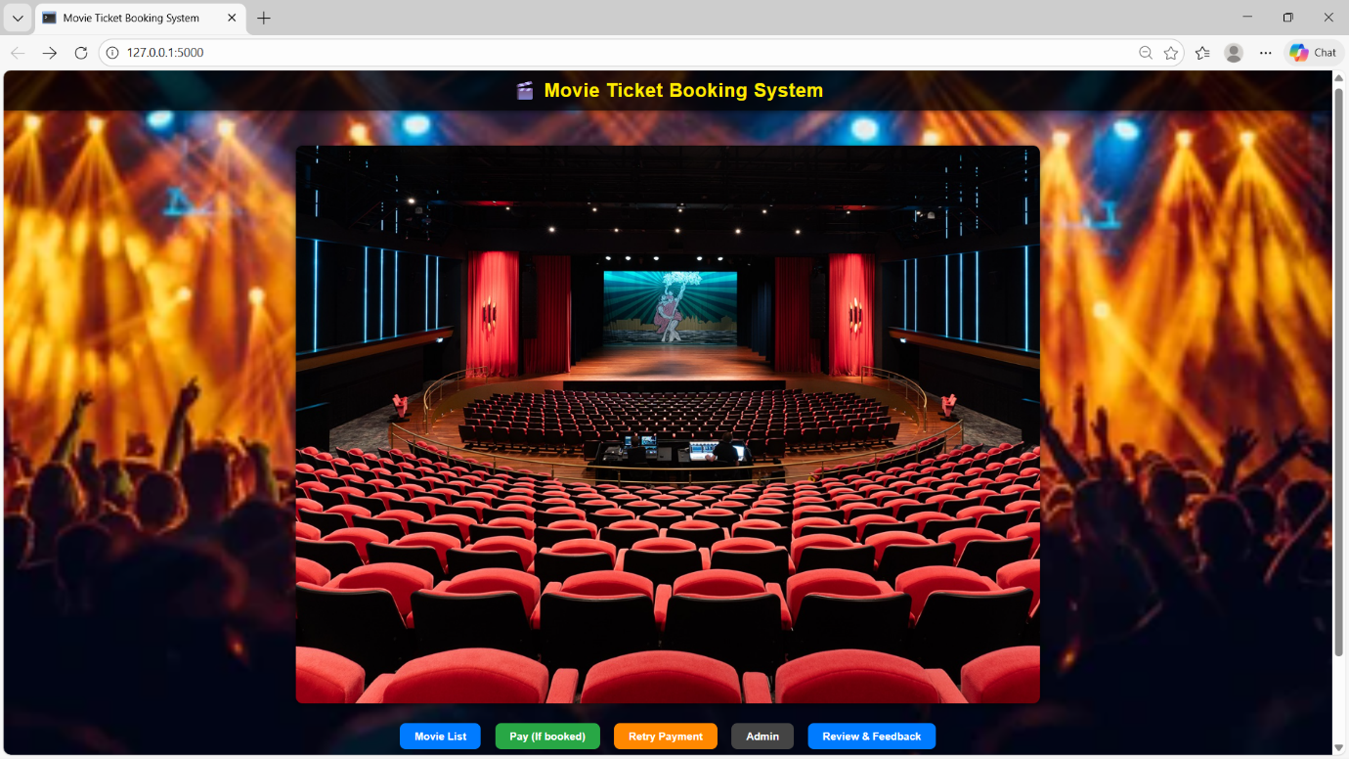
Results and Discussion
HOME PAGE

Slide 23
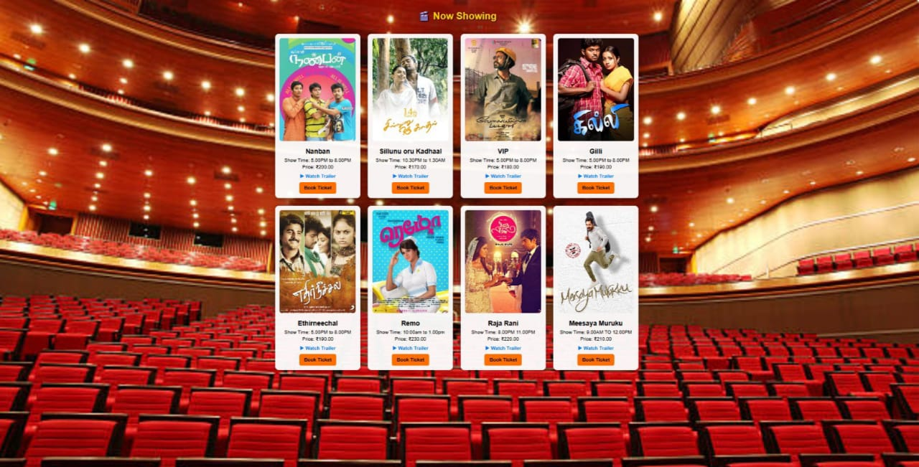
Results and Discussion
MOVIE SHOWING PAGE

Slide 24
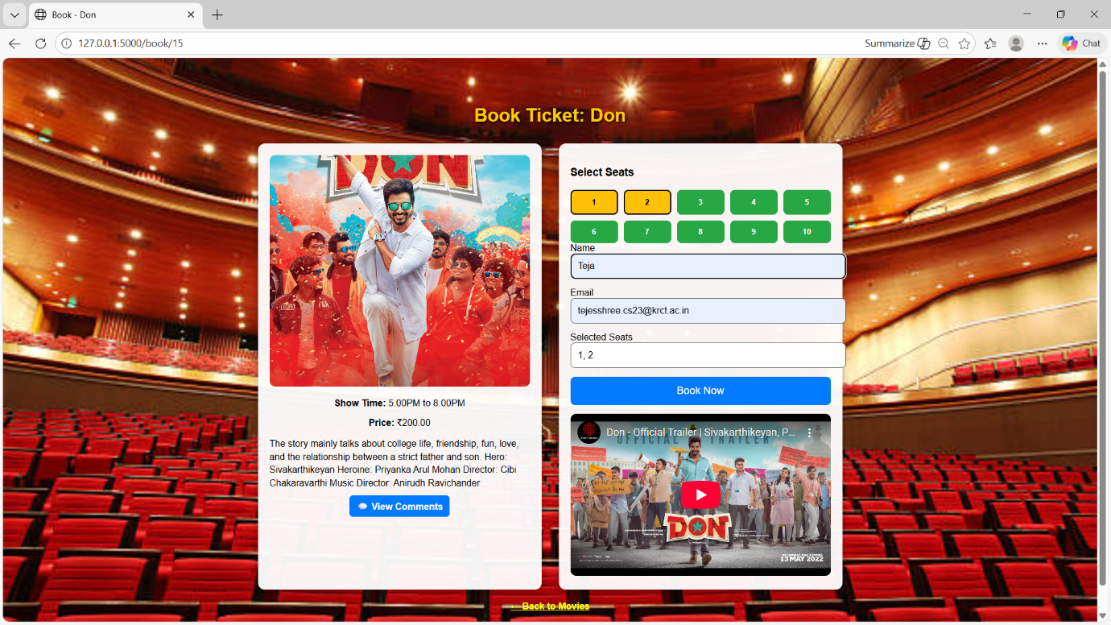
Results and Discussion
TICKET BOOKING PAGE

Slide 25
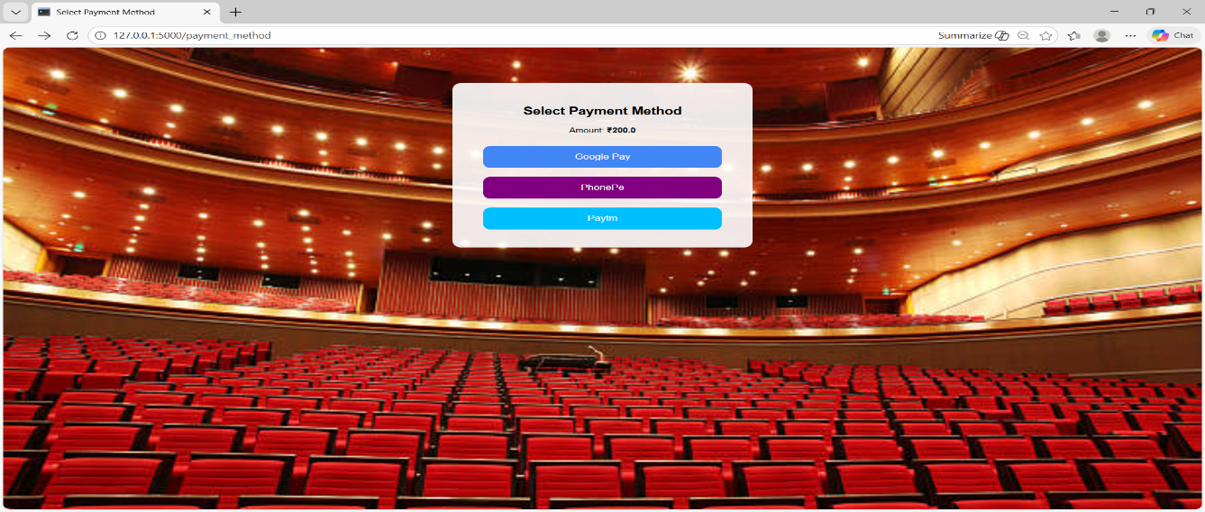
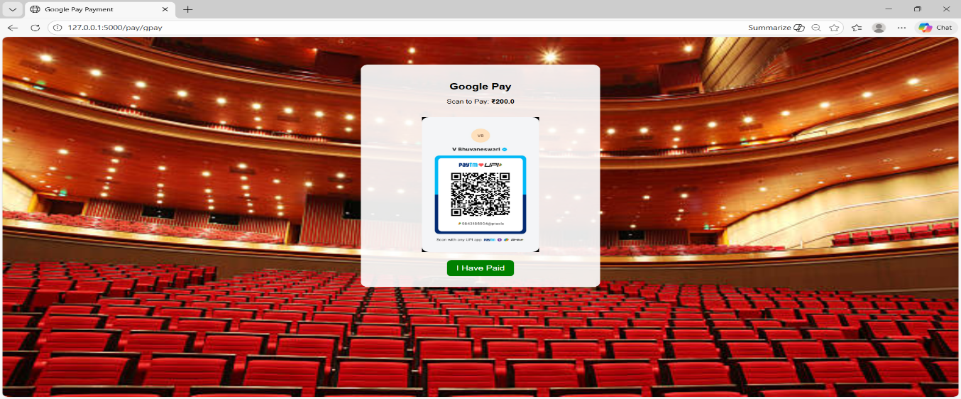
Results and Discussion
PAYMENT METHOD PAGE

Slide 26
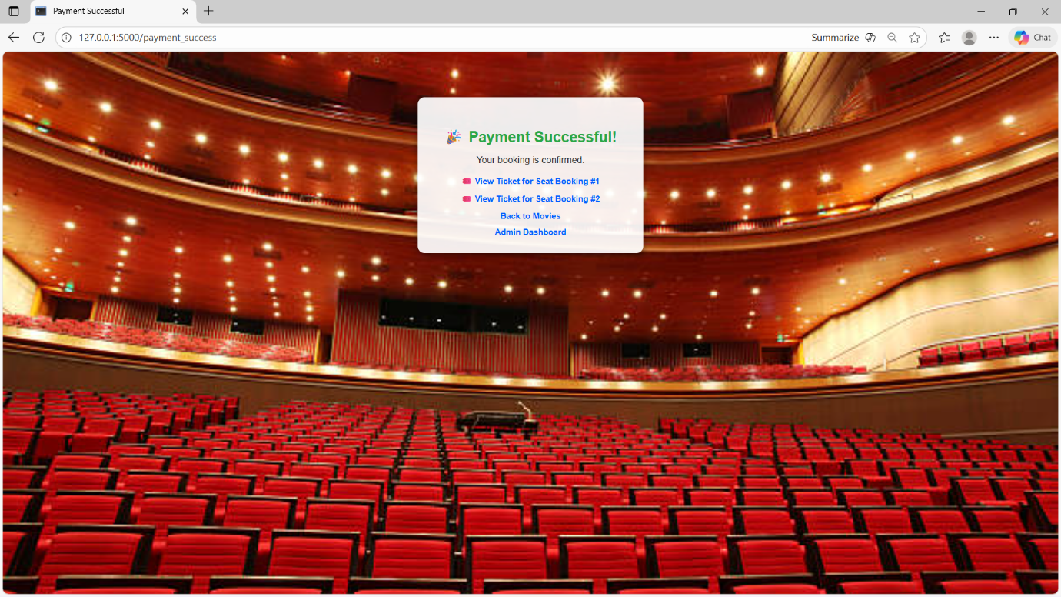
Results and Discussion
PAYMENT SUCCESS PAGE

Slide 27
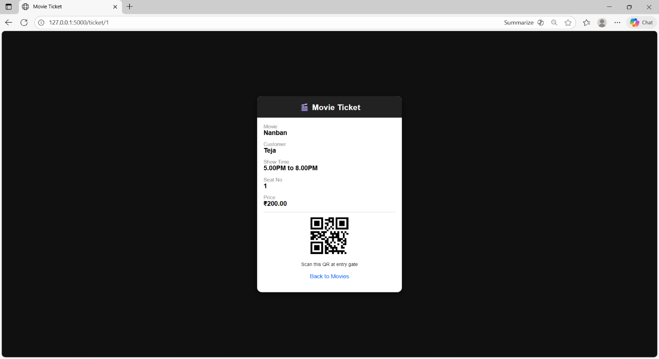
Results and Discussion
TICKET SHOWING PAGE

Slide 28
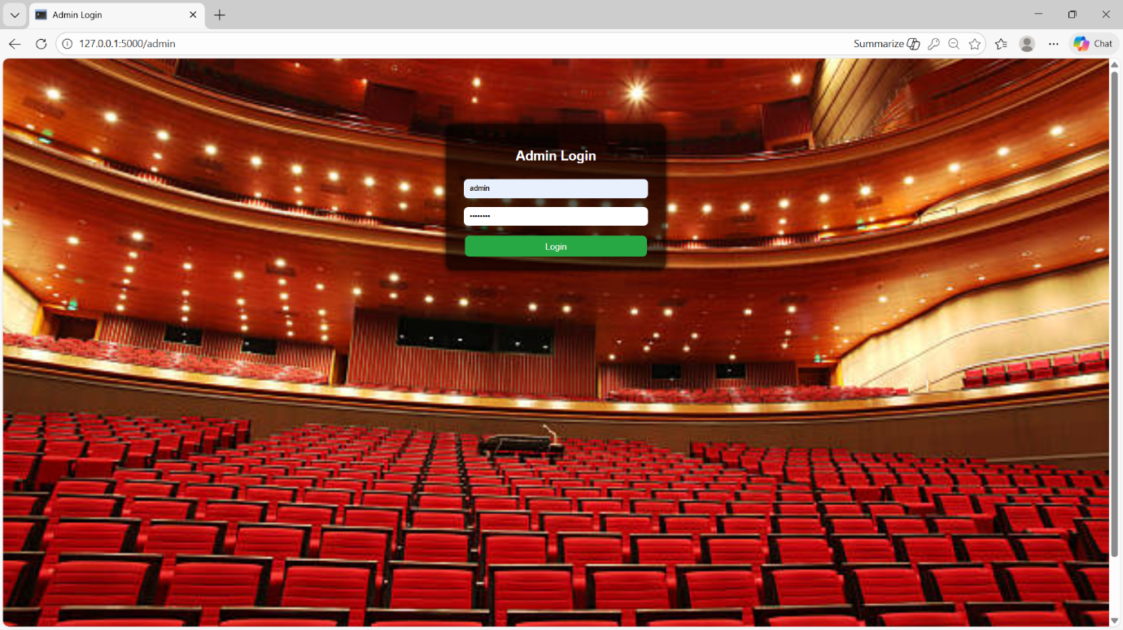
Results and Discussion
ADMIN LOGIN PAGE

Slide 29
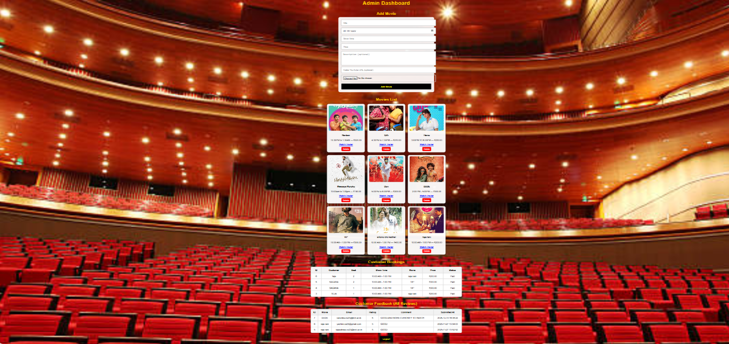
Results and Discussion
ADMIN DASHBOARD

Slide 30
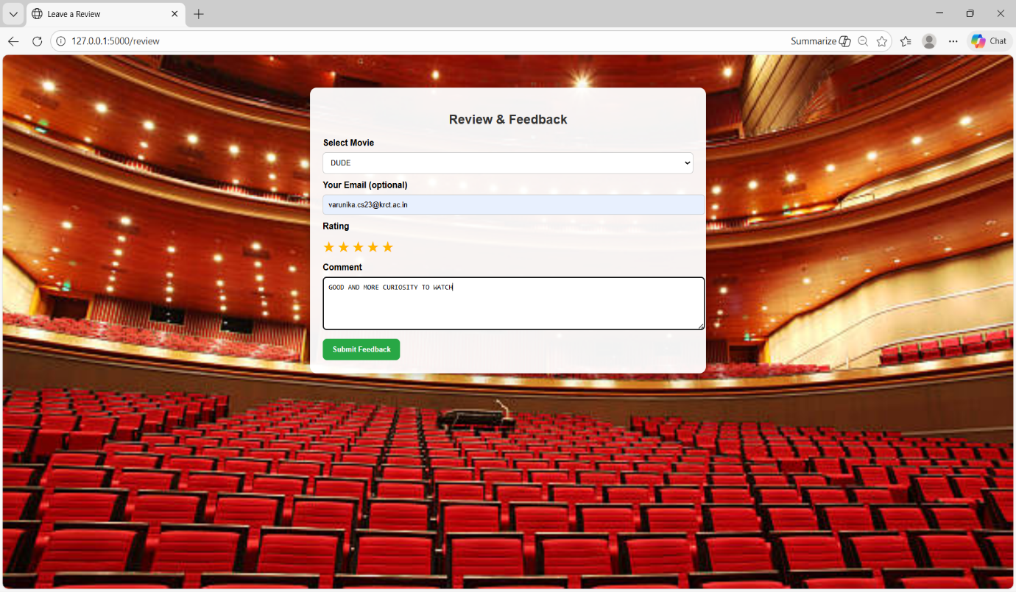
Results and Discussion
REVIEW AND FEEDBACK PAGE

Slide 31
Conclusion
The Movie Ticket Booking System provides a convenient and efficient platform for users to browse movies, book seats, and make secure payments. With its user-friendly interface, real-time seat tracking, and powerful admin controls, the system ensures smooth operation for both customers and administrators while simplifying the entire ticket booking process.

Slide 32
Thank You
Any queries???

